Slide 1
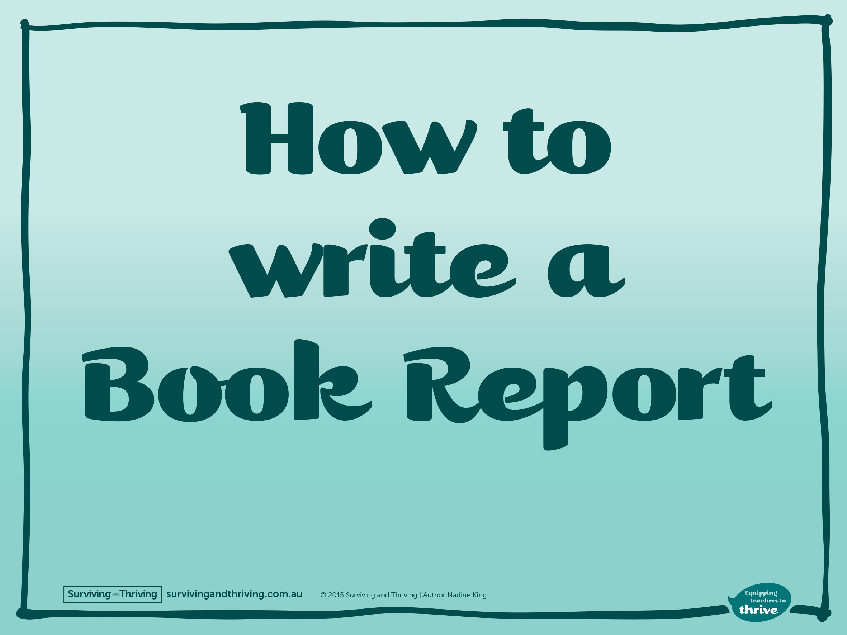

Slide 2
^{Before}
Read the book at least once.
Re-reading gives you a better understanding.
Use a book report template to start making notes.

Slide 3
^{Research}
Key information you should find:
Title
Author
Year of publishing
Genre
Key characters
Main events
Settings
Your opinions
Recommendations

Slide 4
^{Writing}
Use paragraphs. New topic = new paragraph.
No opinion. Only use your opinion when discussing how you liked the book & if you would recommend it to others.
Can contain headings & sub headings.
Can contain pictures or diagrams.
Edit & proofread.

