Slide 1
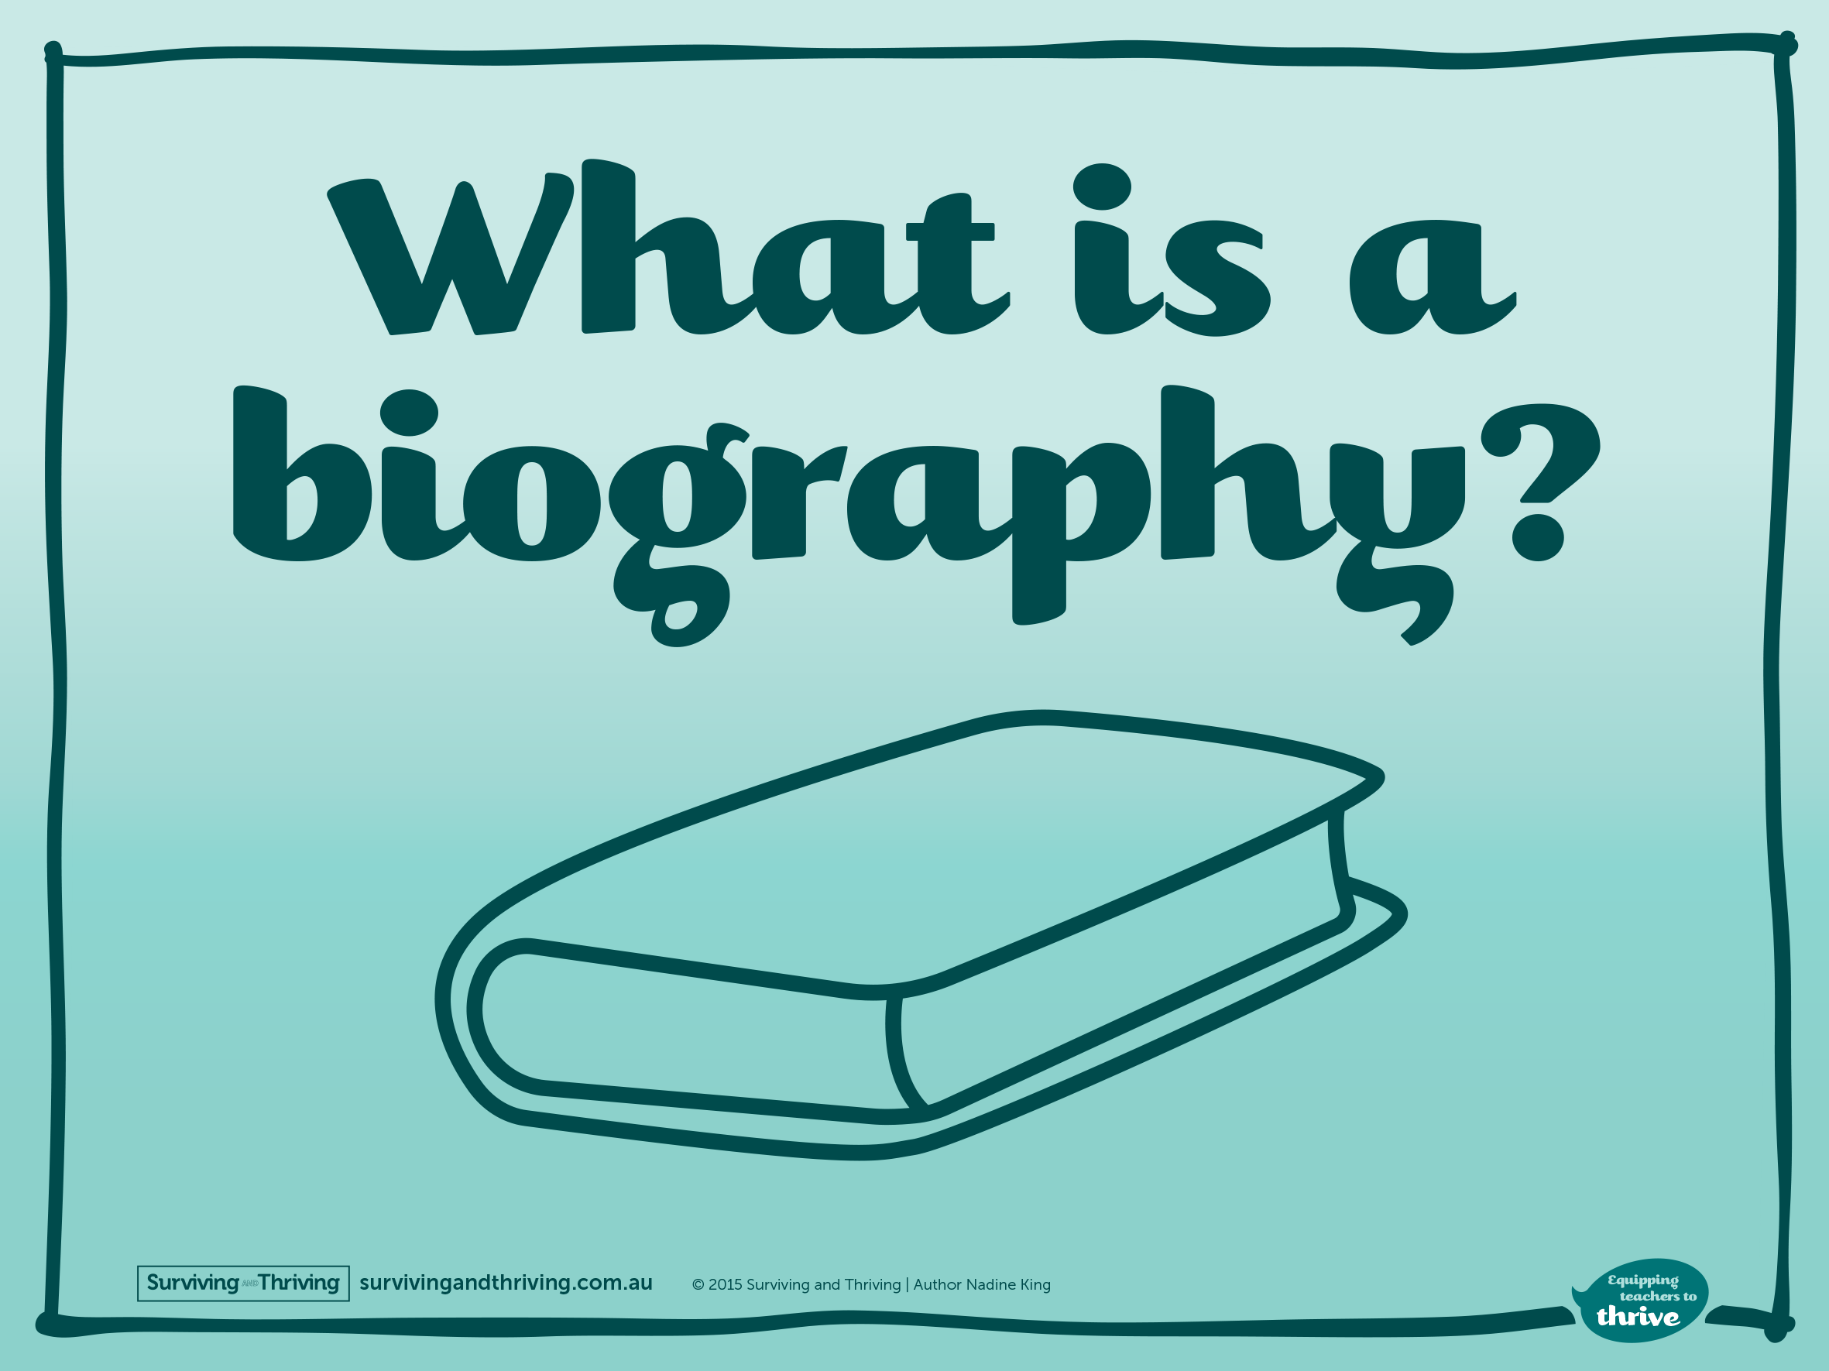

Slide 2
^{Well…}
A biography is simply the story of a life.
Biographies can be just a few sentences long, or they can fill an entire book - or two.

Slide 3
^{What is a Biography?}
Very short biographies tell the basic facts of someone’s life and importance.
Longer biographies include that basic information of course, with a lot more detail, but they also tell a good story.
For example:
Roger Llama lived an interesting life. He was a man with unique and rather questionable interests. Roger’s most consuming love was llamas. He adored them so much he changed his surname to Llama.

Slide 4
^{A well written biography…}
Has a subject who has lived an interesting life.

Slide 5
Takes the reader into the world the subject lives or lived in.
^{Roger’s House}

Slide 6
Contains important facts and details about the subject.

Slide 7
Shares information about the subject that the reader may not know.

Slide 8
Inspires the reader to take some action, whether that is to change an aspect of their own life, or read more about the subject and issues contained in the biography.

Slide 9
Is a story as exciting and gripping as a work of fiction.

Slide 10
Are you up for some fun, fact-finding detective work? We hope so! Before you jump into writing a biography, you need to do some sniffing around — just like a detective — to get all the facts.

