Slide 1
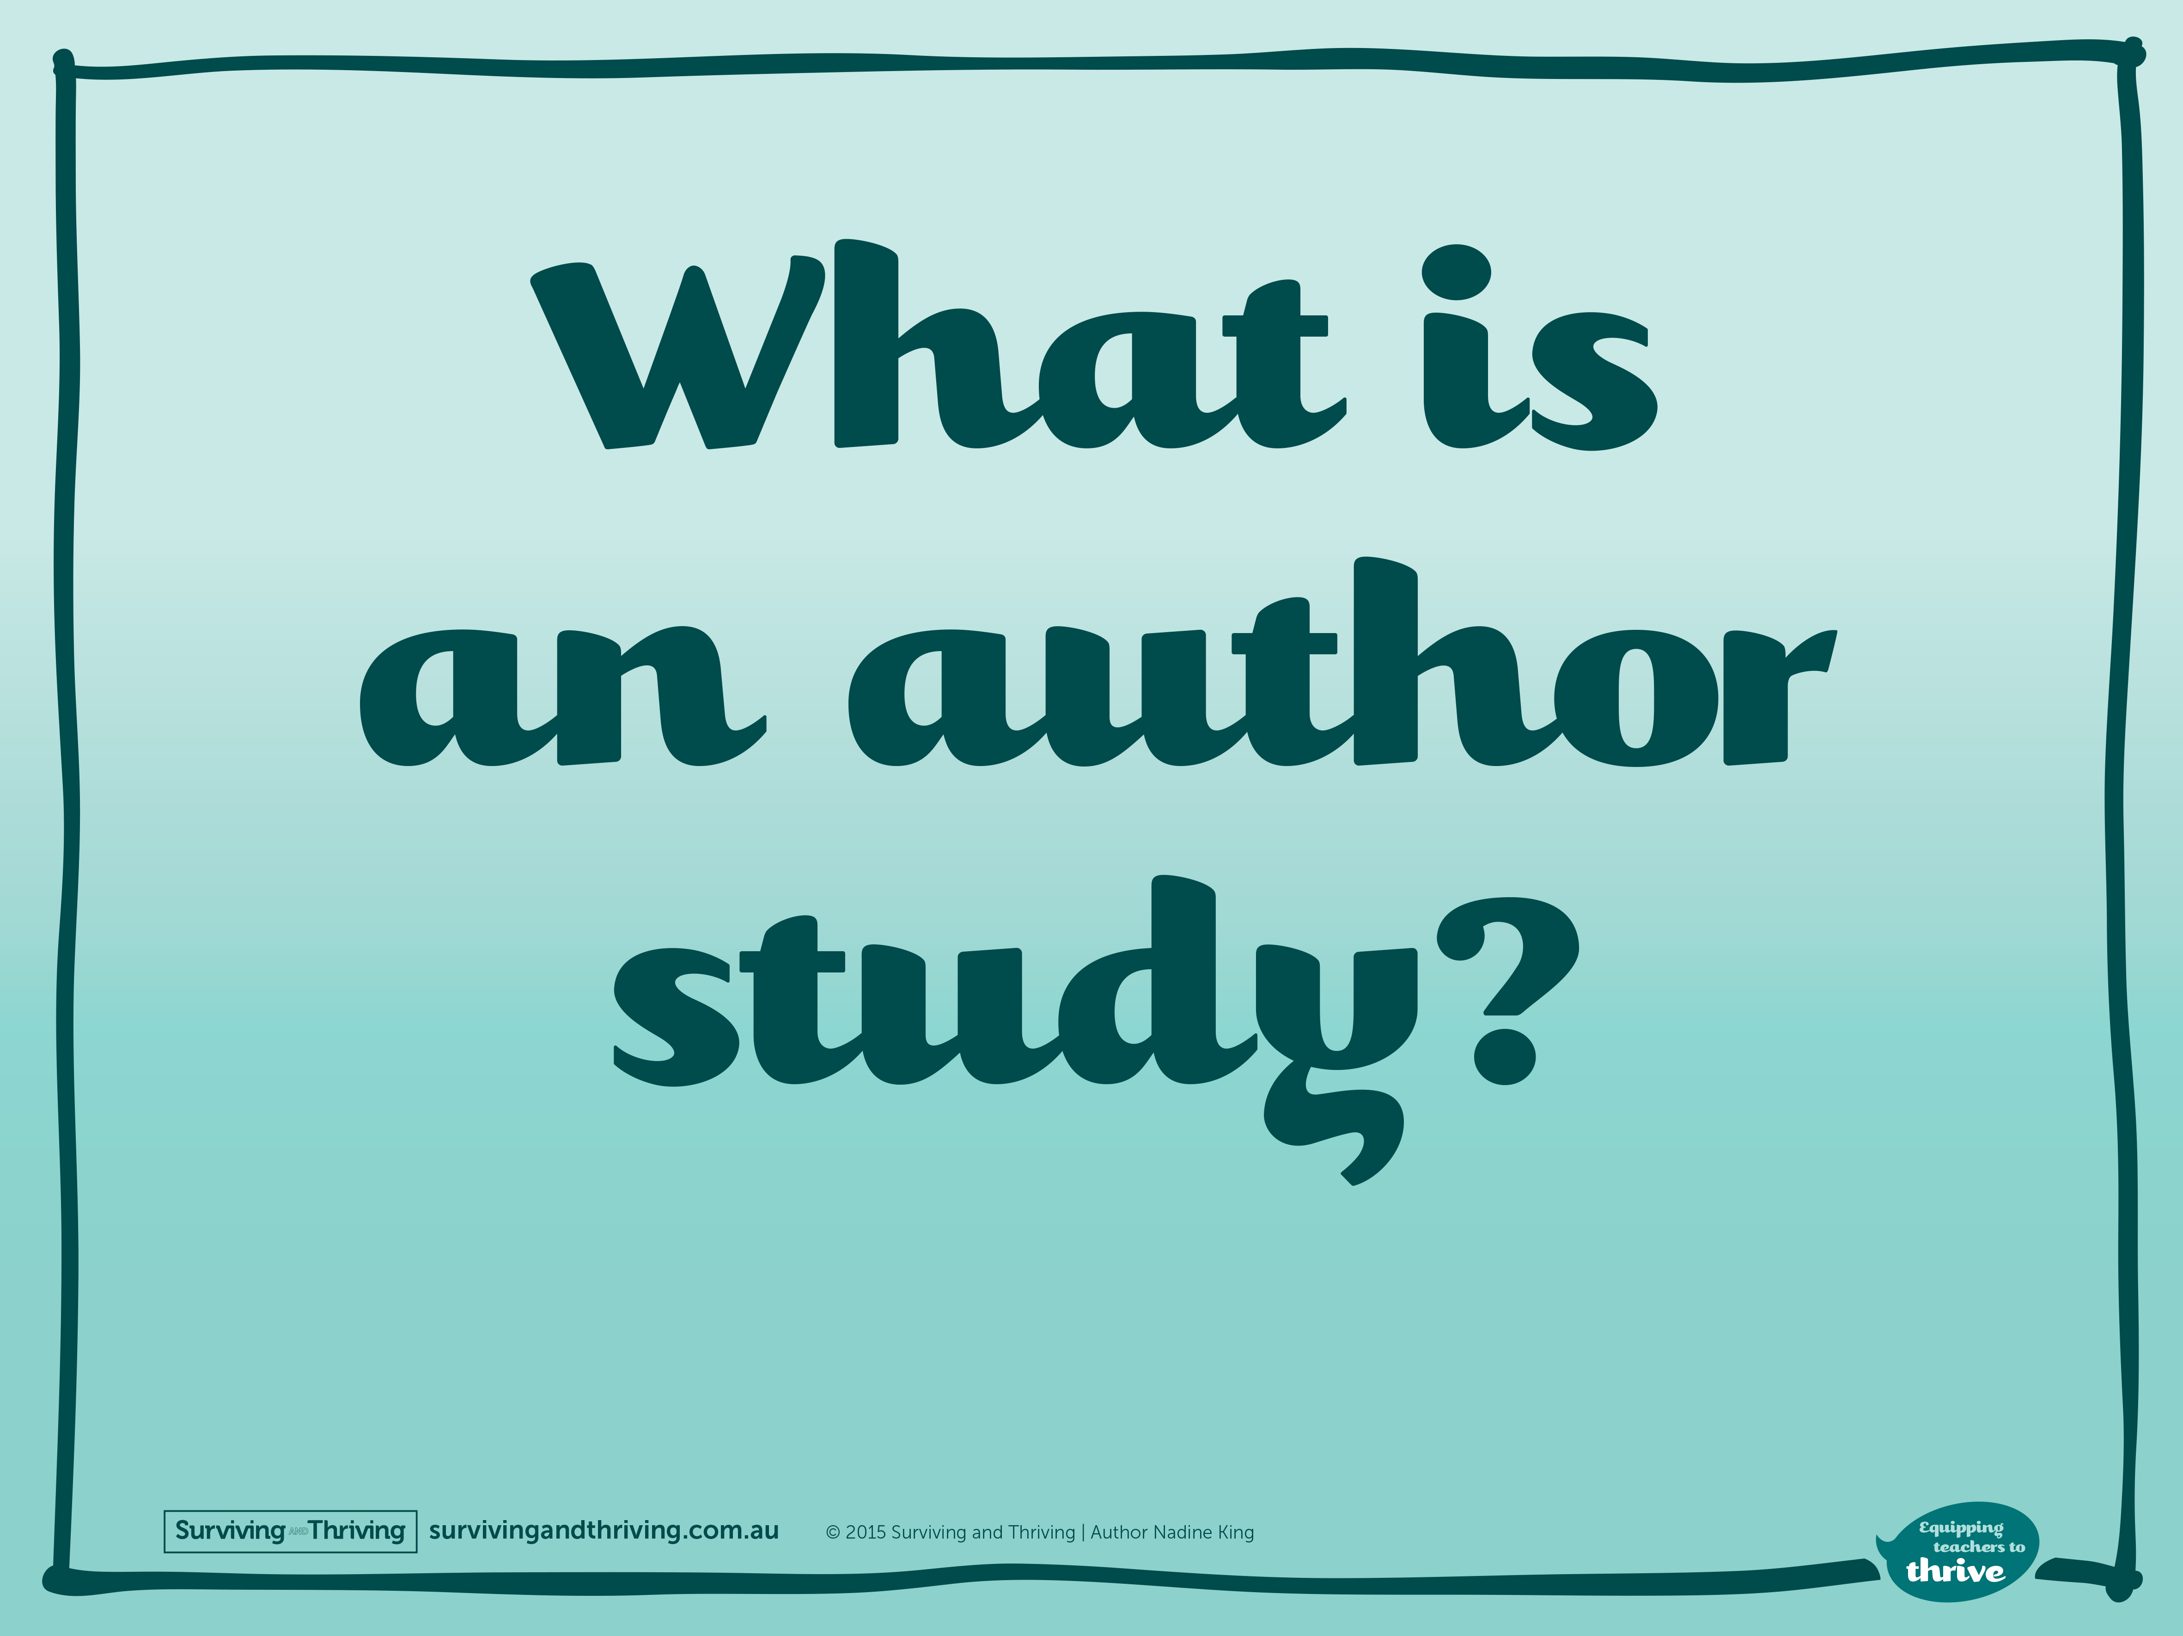

Slide 2
It is the opportunity to find out lots of details about your favourite author.

Slide 3
^{You can learn about:}
Their history
How they write
Themes in their books
Their writing

Slide 4
^{What is an author study?}
It can also help you make personal connections with the author and their characters, as well as an author and their work.

Slide 5
What will I learn when I do an author study?
You will be reading more so your literacy skills will improve.
You will be learning about an author’s life so your research skills will improve.
You will be responding and so your writing skills will improve.

Slide 6
What will I learn when I do an author study?
You will be comparing and contrasting so your critical thinking skills will improve.
You will make stronger connections with books so your love of reading will increase.

Slide 7
^{How do I do an}
^{author study?}
^{It’s simple!}
You choose an author you like or want to learn more about.
You read two or more of their books.
You complete a range of enjoyable activities in a little project.
You present your findings to the class!

